Slide 1
Genome Sciences
7/6/17

Slide 2
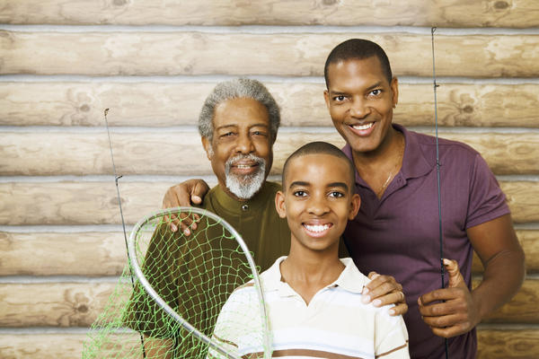
What causes children to look like parents?

Slide 3
genes – basic units of biological information heredity – the way genes transmit physiological, anatomical, and behavioral traits from parents to offspring
Notes:
Genes are passed on from one generation to the next and underlie the formation of every heritable trait. When I say trait, I mean things like eye color, hair color and texture, skin color, whether or not you have a cleft in your chin. Anything that’s observable – we consider those to be traits.

Slide 4
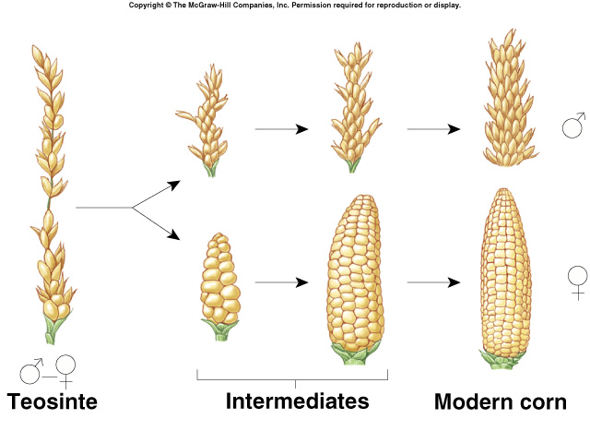
Artificial Selection
Teosinte
Modern
Corn
Notes:
For a long time, humans used genetic concepts without knowing that that’s what they were doing. One example of this was domesticating dogs. They would find a little of semitamed wolves, and keep the friendlier ones as companions and eventually mating. After generations of this purposeful mating, domestic dogs slowly arose from ancestral wolves. Continuing to do this over time has given us lots of different breeds of dogs, from chihuahuas to great danes! This process is called artificial selection. Farmers use this method as well. Ancient corn was actually a bushy grass called Teosinte. Farmers in Mexicio noticed that not all these plants were the same. Some of the plants were bigger, or they tased better, or were easy to grind. They would save the kernels from plants with desirable characteristics and plant them again next season. Over time, the plants grew taller, and the kernels became bigger. With human guidance, we’ve done this with rice, wheat, barley, lentils and dates in Asia, squash, tomatoes, potatoes and peppers in the Americas, yams peanuts and gourds in Africa.

Slide 5
The historical puzzle of inheritance
Desirable traits sometimes disappear and reappear
What is inherited? How is it inherited? What is the role of chance in inheritance?
Notes:
One example of a desirable characteristic was the merino sheep that produce soft, fine wool. Breeding practices in the 1830’s meant that breeders didn’t know if their ram would produce offspring with soft wool or not.

Slide 6


Slide 7
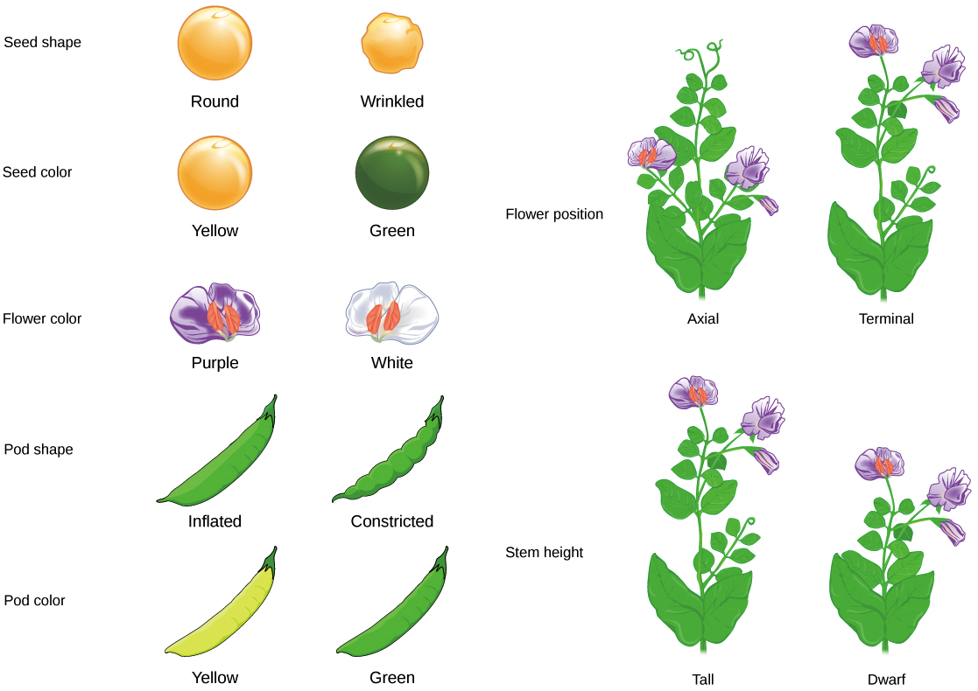
Mendel and his peas
Smart experimental design: peas generate a lot of offspring, easy to cross-pollinate, traits are easily observable (discrete)

Slide 8
Mendel collected pure-breeding lines that produced offspring carrying specific traits that remained constant from generation to generation
He then cross-fertilized pairs of different plants to create hybrids
He also did reciprocal crosses, where he reversed the traits of the male and female parents

Slide 9
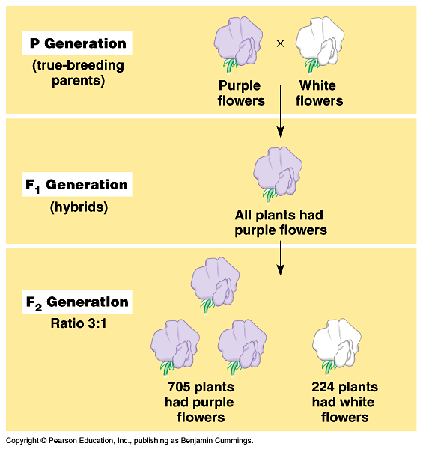
Monohybrid cross
Notes:
Mendel plants peas with pure bred purple flowers and pure bred white flowers and allowed them to grow in to the parental generation (P generation). Then he mated them in the spring. The progeny (the resultant offspring) of the parental generation are what we call the first filial generation (F1 generation). The F1 generation was all purple. To determine if the white flower trait was gone or not, he mated plants of the F1 generation together. This resulted in a second filial generation (F2 generation). Some white flowers came back. Mendel decided that there must be two different kinds of purple flowers. Some that yield only purple offspring and some that sometimes give you white offspring. He called the purple flower trait dominant and the white flower trait recessive.

Slide 10
How to account for the 3:1 ratio in the F2 generation?
Mendel proposed that for each trait, every plant carries two copies of a unit of inheritance, one from each parent.
Today we call these units of inheritance genes and we call each alternate form of the gene an allele
Purple flower allele – dominant
White flower allele - recessive
Notes:
Mendel proposed that each unit of inheritance comes in alternate forms – alleles. Individuals having two different alleles for a single trait are monohybrids.

Slide 11
Law of Segregation
If every plant has two copies of every gene, then how do they pass only one copy to their progeny?
Mendel imagines that two alleles for each trait separate (segregate) during gamete formation, and then unite at random, one from each parent, at fertilization.
Gametes – specialized cells that carry genes between generations (for

Slide 12
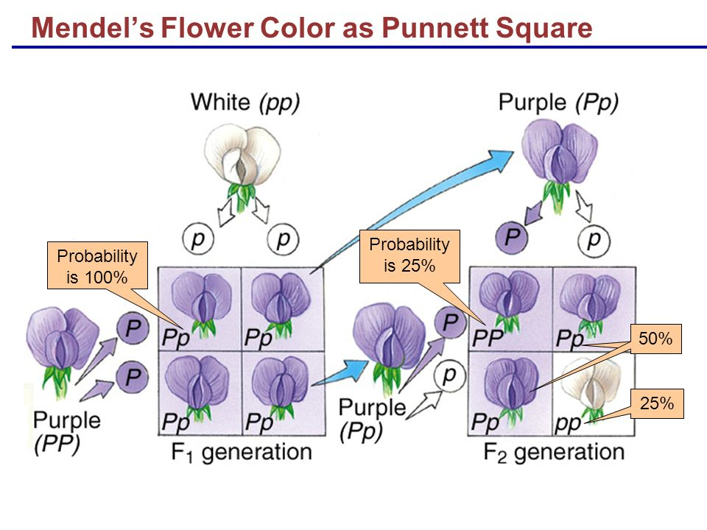
Visualizing crosses with Punnet Squares
Notes:
First we see the law of segregation. The purple and white pure-breeding flowers have alleles that separate during gamete formation. Dominant alleles are denoted with capital letters and recessive alleles are lower case letters. Then when cross-pollination occurs, progeny randomly get an allele from either parent. In this case the only option is to get a dominant gene from the purple dad, so all the progeny are purple. In the second cross. The purple plant now has one dominant allele and one recessive allele. When we cross it with another purple plant from the same F1 generation we see a very distinct pattern emerge. One of the plants gets two dominant genes and one of the plants gets two recessive genes. Two of the plants get one of each. If we just look at the color of the plants, we see a 3:1 ratio (which is what Mendel saw).

Slide 13
Mendel’s results reflect basic rules of probability!
Product rule – probability of two or more independent events occurring together is the product of the probabilities that the events will occur by itself
Probability of event 1 and event 2:
Probability of event 1 x probability of event 2
Notes:
Independent events are events for which the probability of one does not affect the other. Remember in the Punnet square for the F2 generation? The probability of getting forming each gamete is ½. Then the probability of getting a Y egg united with a Y pollen is ½ * ½ which is ¼!.

Slide 14
Sum rule – probability of two mutually exclusive events occurring is the sum of their individual probabilities
Probability of event 1 or event 2:
Probability of event 1 + probability of event 2
Notes:
A mutually exclusive event is one that if one event happens that means the other cannot happen. For instance if Y combines with Y, the same fertilization event cannot have it combine with y. We use the sum rule to find the likelihood that an offspring will be a hybrid. ¼ ( probability of maternal Y uniting with paternal y) + ¼ (probability of paternal Y uniting with maternal y).

Slide 15
Phenotype – an observable characteristic, such as purple or white flowers
Genotype – the actual pair of alleles present in an individual
YY or yy genotype – homozygous
Yy genotype - heterozygous
Notes:
Note that the phenotype of a heterozygote is dependent on whichever allele is dominant.

Slide 16
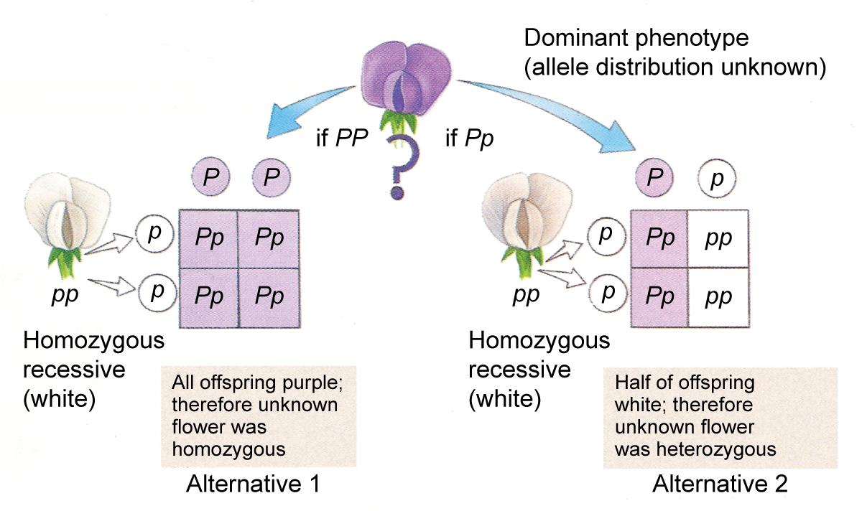
Testcrosses
A way to determine genotype

Slide 17
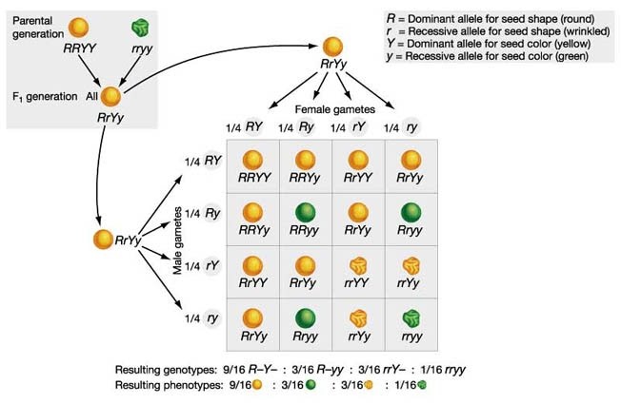
Dihybrid Crosses
Law of Independent Assortment: presence of one allele provides no information about the other alelle

Slide 18
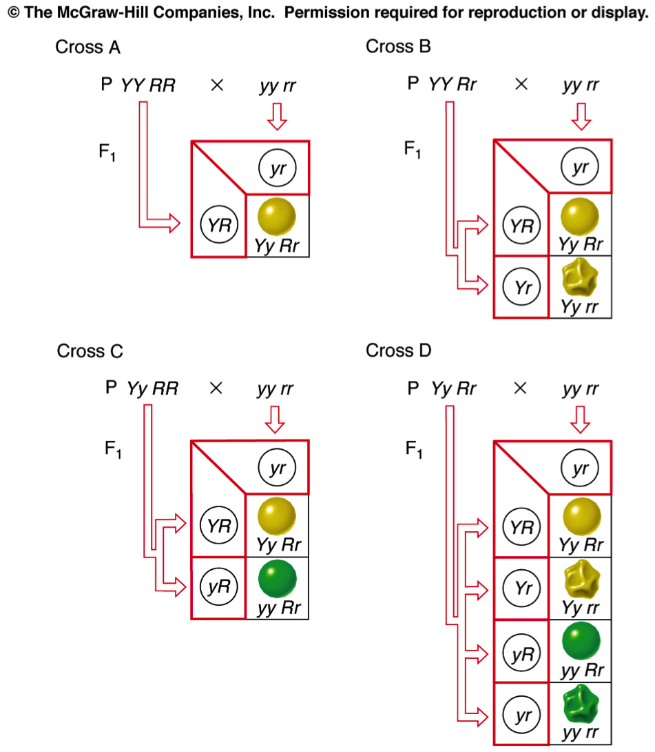
Dihybrid Testcrosses

Slide 19
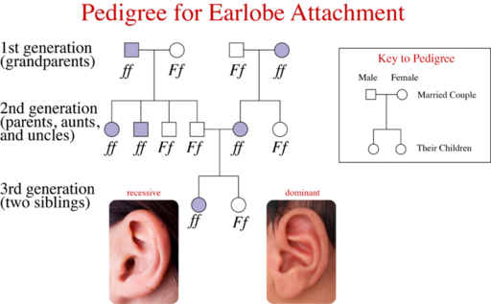
Mendelian Inheritance in Humans

Slide 20
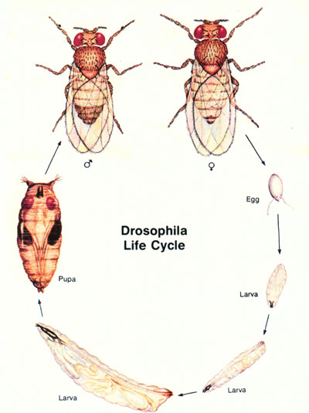
Fly Lab
Fruit flies only have 4 pairs of chromosomes! And only hundreds of genes. This makes them great for studying genetics!
In fruit fly genetics, the normal fly is called the “wild type”.
Any fly exhibiting a phenotypic mutation is called a “mutant”. Their names generally denote t he type of mutation
Notes:
Fruit flies are easy to culture, have a short generation time, and can produce many offspring.

Slide 21
How do you know if your data means anything?
Statistics!
A chi square (X²) statistic is used to investigate whether two distributions differ from each other.
Null hypothesis – there is no difference between the distributions

